Slide 1
Assignment 3.2 Charts
DSC640
Taniya Adhikari

Slide 2
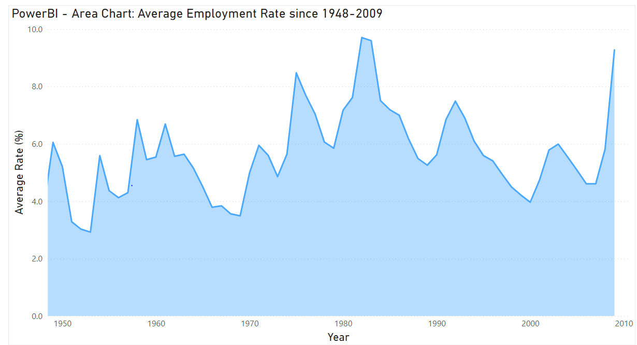
PowerBI – Area Chart

Slide 3
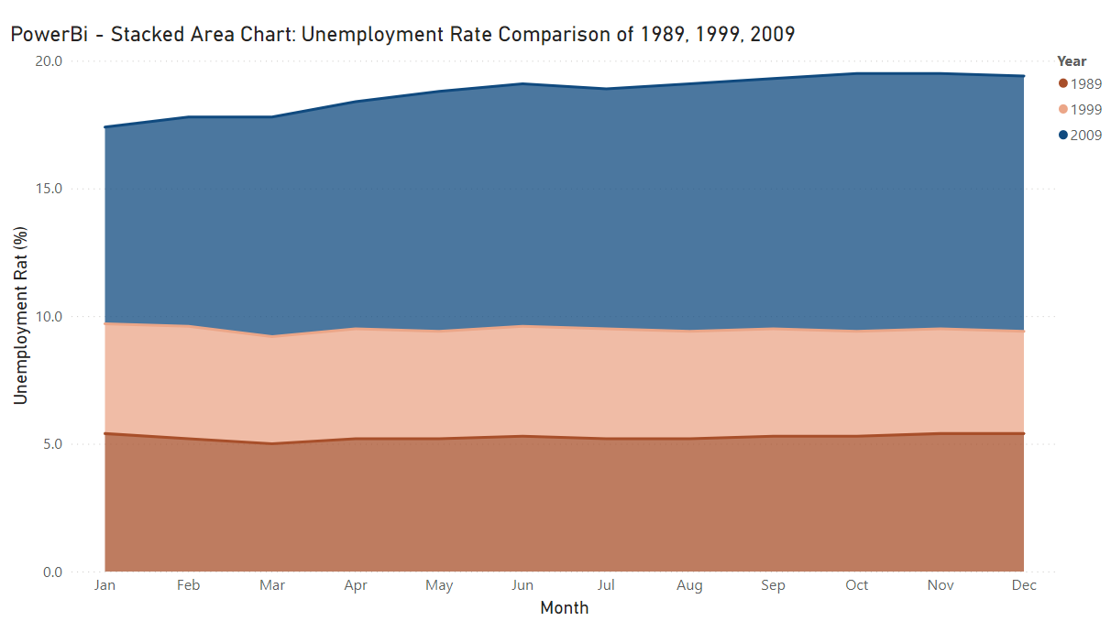
PowerBI – Stacked Area Chart

Slide 4
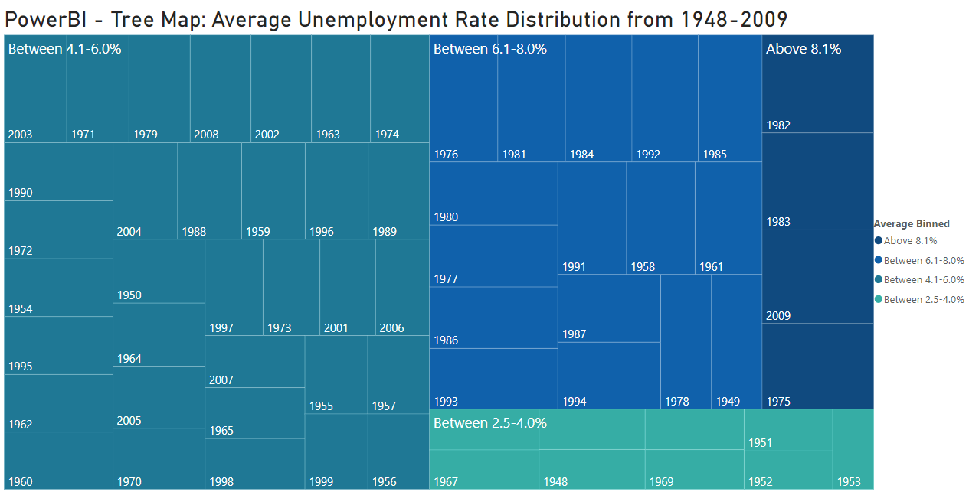
PowerBI – Tree Map
Note: Average Unemployment Rate is binned into categories to plot Tree Maps

Slide 5
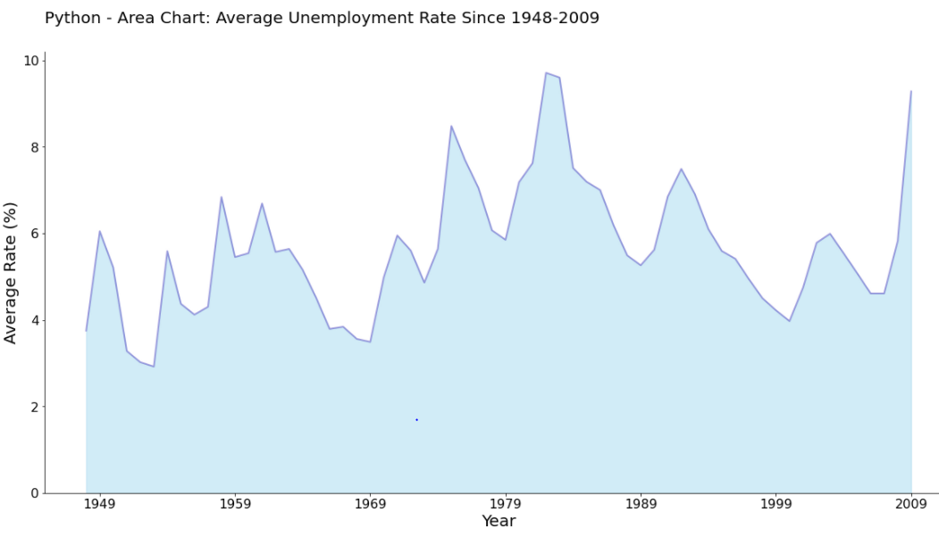
Python – Area Chart

Slide 6
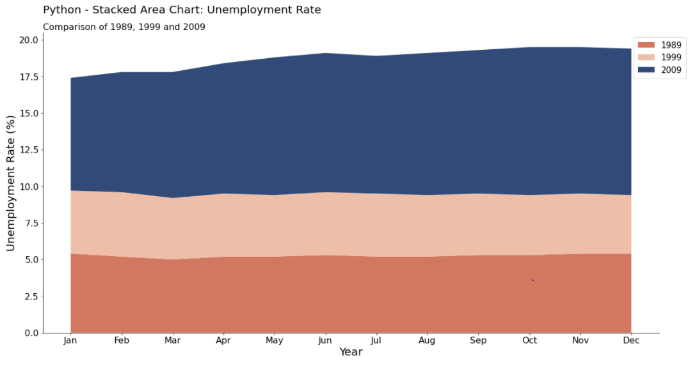
Python – Stacked Area Chart

Slide 7
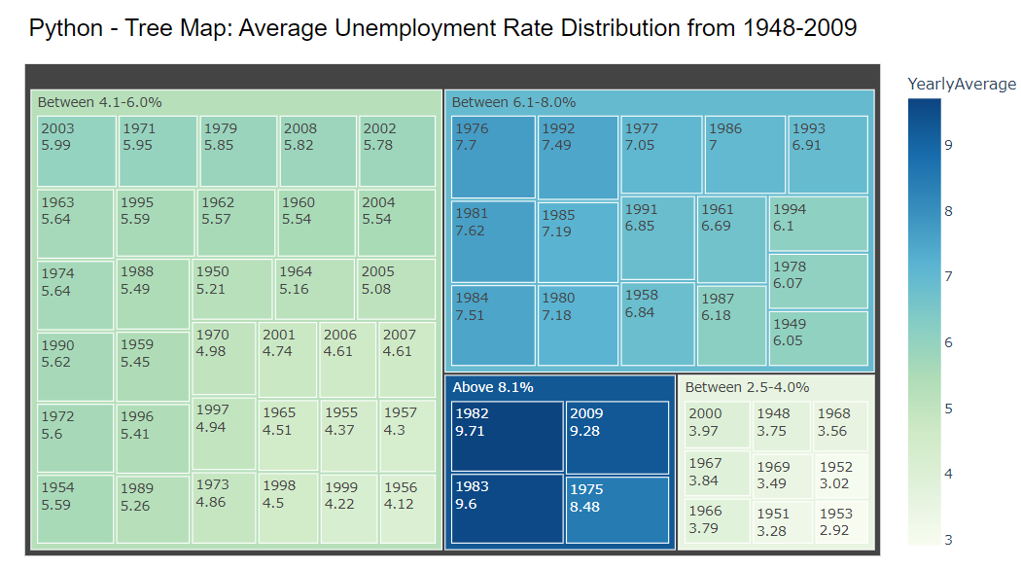
Python – Tree Map
Note: Average Unemployment Rate is binned into categories to plot Tree Maps

Slide 8
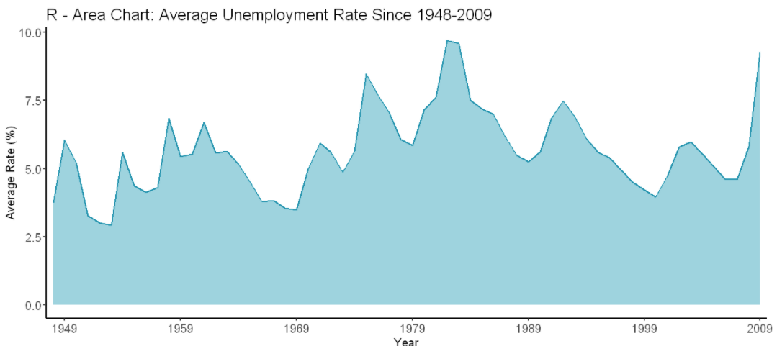
R – Area Chart

Slide 9
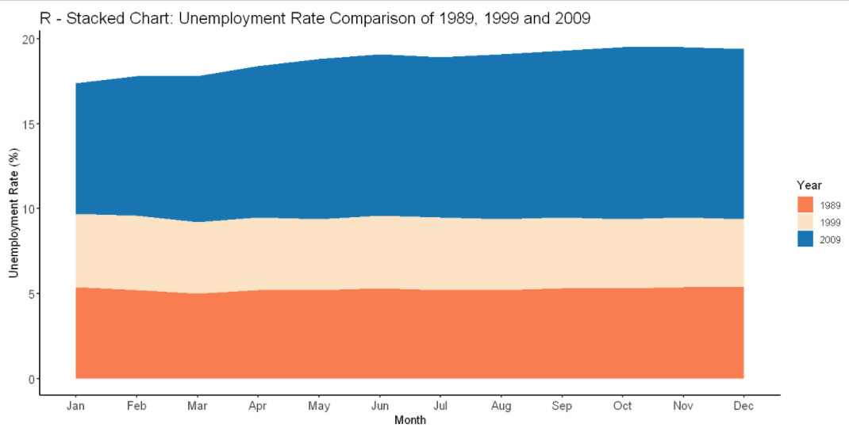
R – Stacked Area Chart

Slide 10
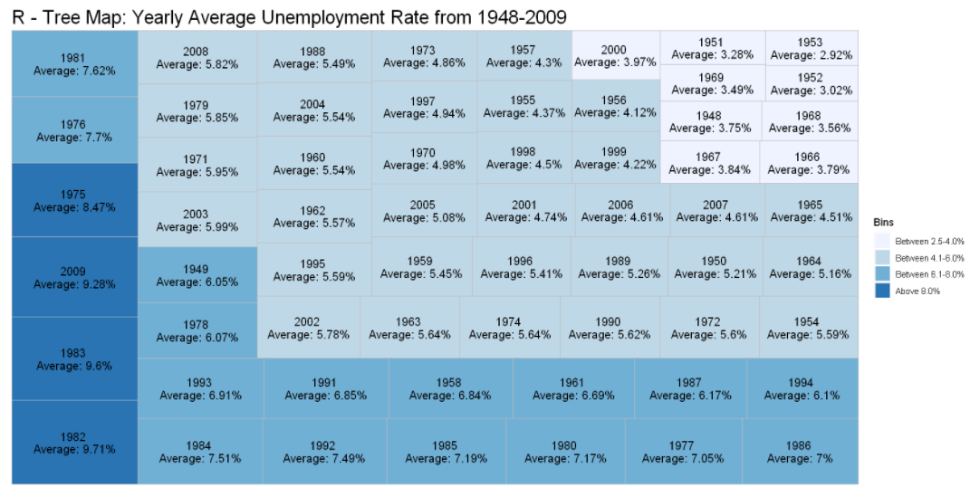
R – Tree Map
Note: Average Unemployment Rate is binned into categories to plot Tree Maps

Slide 11
Supplemental Files
Python Code
R Code
PowerBI Screenshot

